Slide 1
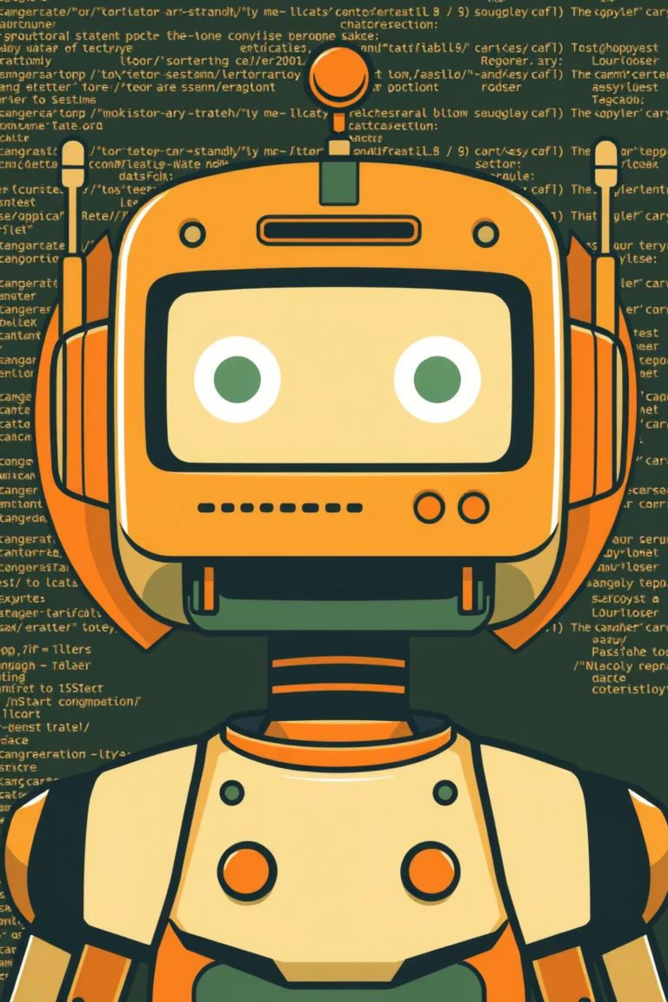
Chatbot client-server
This project focuses on building a client–server chat application with a chatbot-enabled server. The system is designed to allow multiple clients to connect simultaneously and communicate with a server that responds automatically using a simple chatbot logic.

Slide 2
Chatbots
1) Rule-Based Chatbots:
Follow predefined rules and keywords (“Hello” → “Hi”).
Limited to expected inputs.
Key Features
Available 24/7
Instant responses
Reduces repetitive human work
Used in customer service, sales, education, and bookings
2) AI-Powered Chatbots:
Use artificial intelligence to understand and respond to new
questions
Example (ChatGPT, Siri, Alexa).
Everyday Examples
WhatsApp customer support bots
Banking website chat assistants
ChatGPT for learning and problem-solving

Slide 3
Chatbot Responses: Rules and Emotions
The chatbot's responses are defined in a Python dictionary, categorized for various interactions. This section details the predefined responses for different user inputs.
Greetings
Personal
Feelings
"hello": ["Hello!", "Hi 👋", "Hey!", "Hello there 😊"]
"how are you": ["I'm fine 😊", "Doing great!", "All good, thanks"]
"i am sad": ["I'm sorry to hear that 😔", "Everything will be okay ❤️"]
"hi": ["Hi!", "Hey!", "Hello!"]
"your name": ["I'm a chatbot 🤖", "You can call me AI Bot"]
"i am happy": ["That's great 😄", "I'm happy for you!"]
"good morning": ["Good morning ☀️", "Morning! Have a nice day"]
"who are you": ["I'm a rule-based chatbot", "I'm here to help you"]
"i am tired": ["Take some rest 😴", "You deserve a break"]
"good evening": ["Good evening 🌙", "Hope your evening is great"]
"what can you do": ["I can chat with you", "I can answer questions", "I can help with programming and study"]
"i am bored": ["Let's talk 😄", "Try learning something new"]
"good night": ["Good night 😴", "Sweet dreams"]

Slide 4
Chatbot Responses: Study and Programming
The chatbot also provides responses related to academic and technical topics, offering encouragement and information.
Study
Programming
Networking
"study": ["Studying helps your future", "Study a little every day"]
"programming": ["Programming solves problems", "Programming needs logic"]
"socket": ["Sockets connect client and server"]
"tcp": ["TCP is reliable and connection-oriented"]
"exam": ["Good luck in your exam 🍀", "Stay calm and confident"]
"python": ["Python is easy and powerful", "Python is great for AI"]
"udp": ["UDP is fast but unreliable"]
"project": ["Projects build real skills", "Work step by step"]
"c++": ["C++ is fast and powerful", "C++ is used in systems"]
"ip": ["IP identifies devices on a network"]
"java": ["Java is platform independent"]

Slide 5
Chatbot Responses: General Help and Farewell
This section covers general utility responses, including help, jokes, weather inquiries, and polite farewells.
General
Thanks & Bye
"help": ["You can ask about programming, study, networking, time, date", "Try asking me something 😊"]
"thank": ["You're welcome 😊", "No problem!", "Anytime 👍"]
"thanks": ["Glad to help!", "You're welcome 😄"]
"joke": ["Why do programmers hate nature? Too many bugs 😂", "Why was the computer cold? It forgot to close Windows 😂"]
"bye": ["Goodbye 👋", "See you later!", "Take care ❤️"]
"exit": ["Bye 👋", "Hope to see you again"]
"weather": ["I can't check live weather, but I hope it's nice ☀️", "Weather depends on your location 🌍"]

Slide 6
Chatbot Core Functions
The chatbot's functionality relies on several key Python functions for processing messages, validating network parameters, and handling client connections.
chatbot_response(message)
Processes incoming messages, converts them to lowercase, and checks for keywords to return a predefined response. It also handles time and date queries. If no keyword matches, it returns a generic "didn't understand" message.
def chatbot_response(message):
message = message.lower()
if "time" in message:
return "Current time: " + datetime.datetime.now().strftime("%H:%M:%S")
if "date" in message or "day" in message:
return "Today's date: " + datetime.datetime.now().strftime("%Y-%m-%d")
for key in responses:
if key in message:
return random.choice(responses[key])
return random.choice([
"Sorry, I didn't understand that

Slide 7
Server Setup and Client Handling
The server is designed to handle multiple clients concurrently using multi-threading, ensuring a responsive and scalable chatbot service.
IP and Port Configuration
The server prompts the user to enter a valid IP address (e.g., 127.0.0.1 or 0.0.0.0) and a port number (1024-65535). Input validation ensures correct network parameters.
while True:
HOST = input("Enter IP to bind (e.g. 127.0.0.1 or 0.0.0.0): ")
if is_valid_ip(HOST) or HOST == "0.0.0.0":
break
print("

Slide 8
Console Client Implementation
The console client provides a basic command-line interface for users to interact with the chatbot server. It handles IP and port validation, connects to the server, and manages message exchange.
1
IP and Port Input
The client prompts the user for the server's IP address and port, validating the input to ensure a proper connection.
while True:
HOST = input("Enter Server IP: ")
if is_valid_ip(HOST):
break
print("

Slide 9
Graphical User Interface (GUI) Client
The GUI client, built with Tkinter, offers a more user-friendly experience for interacting with the chatbot. It includes separate screens for login and chat, along with robust input validation.
ChatClientGUI Class
build_login_ui()
Initializes the Tkinter window and sets up the client's state. It manages the transition between the login and chat interfaces.
Creates the login screen with input fields for Server IP, Port, and Username, and a "Connect" button.
class ChatClientGUI:
def __init__(self, root):
self.root = root
self.root.title("Chatbot Client")
self.root.geometry("500x500")
self.client = None
self.build_login_ui()
def build_login_ui(self):
self.clear_screen()
tk.Label(self.root, text="Chatbot Login", font=("Arial", 16)).pack(pady=10)
tk.Label(self.root, text="Server IP").pack()
self.ip_entry = tk.Entry(self.root)
self.ip_entry.pack()
tk.Label(self.root, text="Port").pack()
self.port_entry = tk.Entry(self.root)
self.port_entry.pack()
tk.Label(self.root, text="Username").pack()
self.username_entry = tk.Entry(self.root)
self.username_entry.pack()
tk.Button(self.root, text="Connect", command=self.connect).pack(pady=10)

Slide 10
GUI Client: Chat Interface and Connection Logic
Once connected, the GUI client transitions to a chat interface, enabling seamless communication with the chatbot. It also handles connection attempts and error messages.
build_chat_ui()
connect()
Constructs the chat interface, featuring a disabled text area for displaying messages and an entry field for user input, along with a "Send" button.
Attempts to connect to the server using the provided IP, port, and username. It validates inputs and displays error messages if the connection fails.
def build_chat_ui(self):
self.clear_screen()
self.chat_area = tk.Text(self.root, state="disabled")
self.chat_area.pack(padx=10, pady=10, expand=True, fill="both")
self.msg_entry = tk.Entry(self.root)
self.msg_entry.pack(padx=10, pady=5, fill="x")
self.msg_entry.bind("", lambda event: self.send_message())
tk.Button(self.root, text="Send", command=self.send_message).pack(pady=5)
def connect(self):
ip = self.ip_entry.get()
port = self.port_entry.get()
username = self.username_entry.get()
if not is_valid_ip(ip):
messagebox.showerror("Error", "Invalid IP address")
return
try:
port = int(port)
if not is_valid_port(port):
raise ValueError
except:
messagebox.showerror("Error", "Invalid Port")
return
if username.strip() == "":
messagebox.showerror("Error", "Username required")
return
try:
self.client = socket.socket(socket.AF_INET, socket.SOCK_STREAM)
self.client.connect((ip, port))
self.client.send(username.encode())
except:
messagebox.showerror("Error", "Connection failed")
return
self.username = username
self.build_chat_ui()
threading.Thread(target=self.receive_messages, daemon=True).start()

Slide 11
GUI Client: Messaging and Application Lifecycle
This section details how the GUI client handles sending and receiving messages, updating the chat display, and managing the application's lifecycle.
send_message()
receive_messages()
display_message()
Sends the user's message to the server, displays it in the chat area, and clears the input field. If the message is "bye", it closes the client connection and exits the application.
Runs in a separate thread to continuously receive messages from the server. It decodes and displays chatbot replies in the chat area.
Appends new messages to the chat display area, ensuring the latest messages are always visible by scrolling to the end.
def receive_messages(self):
while True:
try:
reply = self.client.recv(1024).decode()
if not reply:
break
self.display_message(f"Bot: {reply}")
except:
break
def display_message(self, message):
self.chat_area.config(state="normal")
self.chat_area.insert(tk.END, message + "\n")
self.chat_area.config(state="disabled")
self.chat_area.see(tk.END)
def send_message(self):
message = self.msg_entry.get()
if message == "":
return
self.client.send(message.encode())
self.display_message(f"You: {message}")
self.msg_entry.delete(0, tk.END)
if message.lower() == "bye":
self.client.close()
self.root.quit()
# ======== Run App ======
root = tk.Tk()
app = ChatClientGUI(root)
root.mainloop()

Slide 12
عبدالرحمن الشربيني
أحمد الفقي
عبدالله الششتوي
فوزي محمد
مصعب عمر
زكريا جارالنبي

